Slide 1

Species ranges II – applied issues, temporal dynamics (+ intro to metapopulations)
Petr Keil
Notes:
Hi, my name is Petr Keil and this is my project Biodiversity dynamics across a continuum of space, time, and their scales.

Slide 2
Geographic range vs extinction risk and conservation status
How small ranges make species vulnerable
Notes:
I am qualified to deliver all this

Slide 3
Extinction vs Extirpation
Extinction:
Termination of a species (or a group of taxa). It no longer exists anywhere else in the world.
Extirpation:
A species or a population no longer exist in a specific region. The species still exists in another region.
Sometimes called “local extinction” or “regional extinction”
Notes:
And this is what I will address
The grand objective is to figure out…
Specifically, BEAST will ………………………
I will do this in 5 work packages.

Slide 4
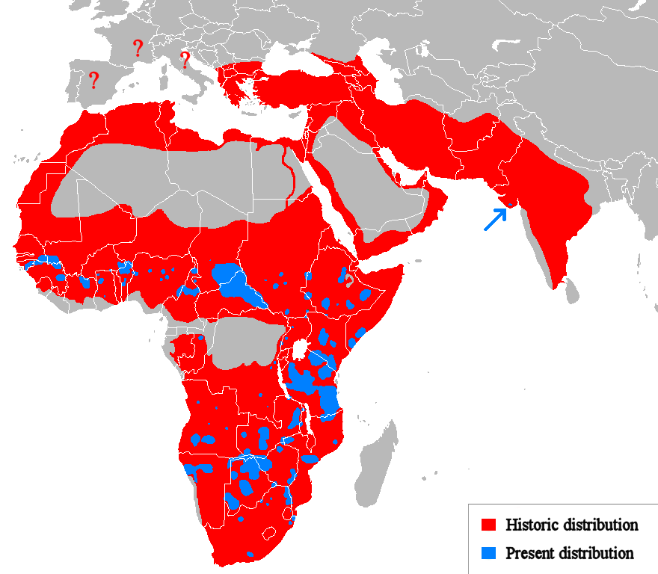
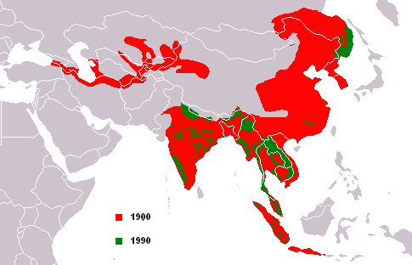
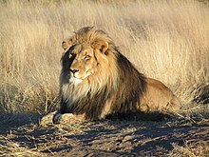
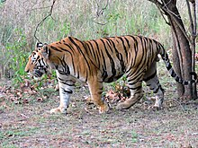
Extirpation - examples
Panthera leo
Panthera tigris
Bauer et al. (2015) PNAS
Notes:
Third, my own theory predicts that global and local diversity loss are disconnected
We have global extinctions where the entire species is lost, but these are rare species, and have little effect on an average local community
We have local extinctions where species are lost from only parts of range. These can affect local diversity, but NOT global extinction rates

Slide 5
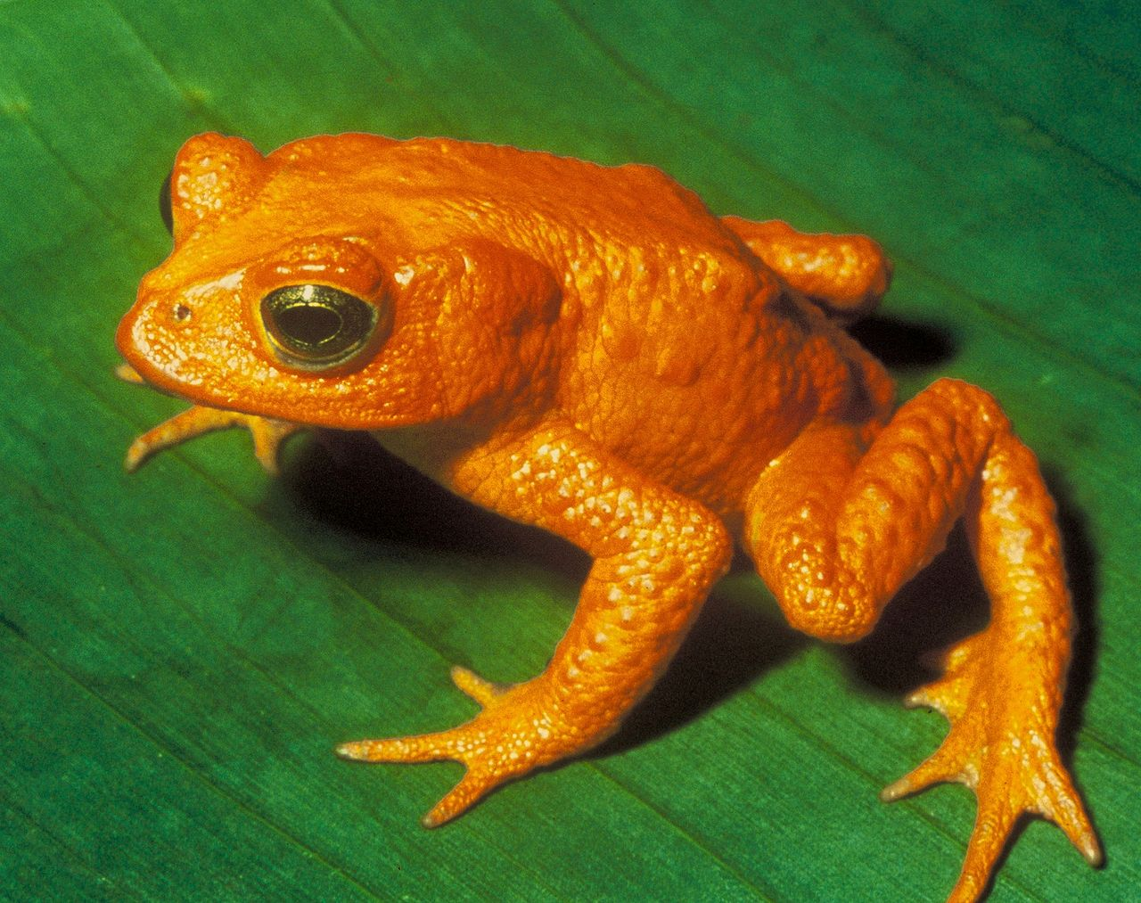
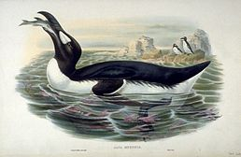
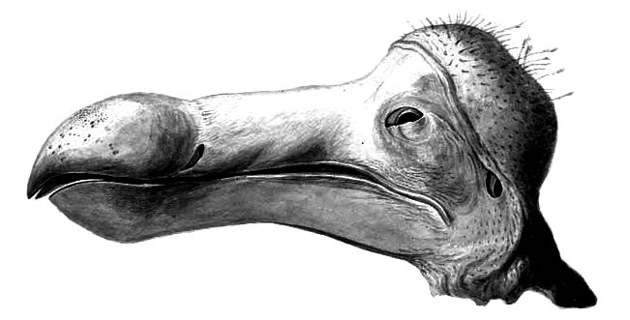
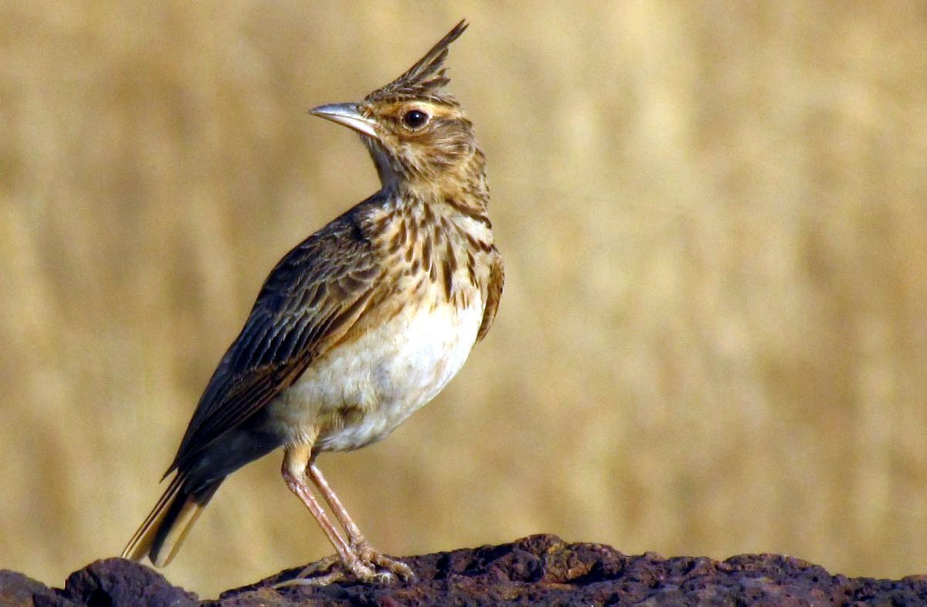
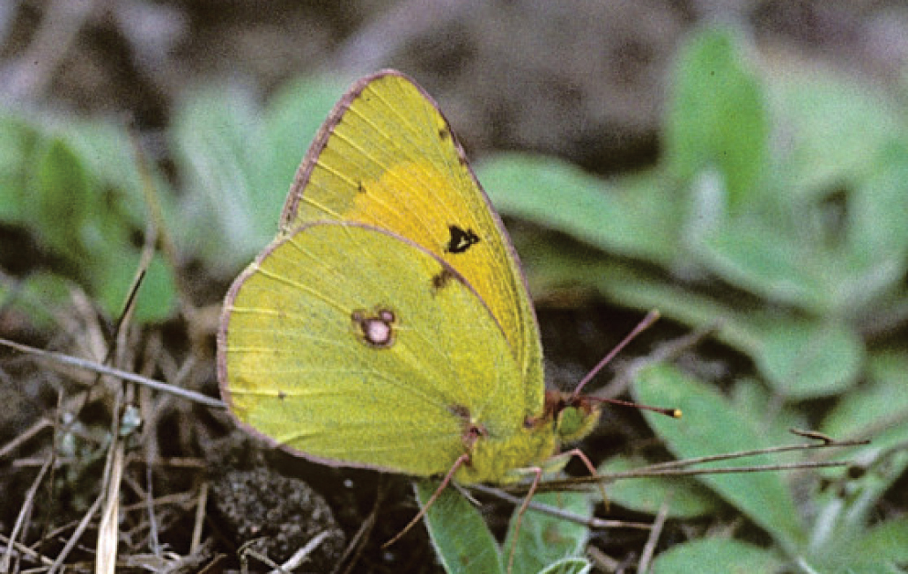
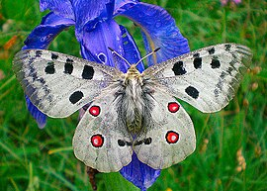
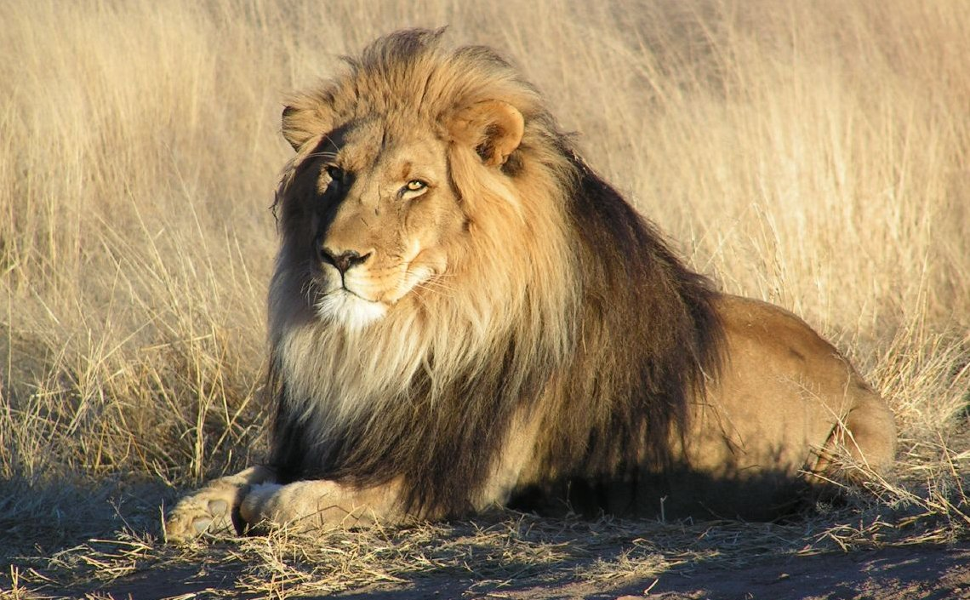
Extinction vs Extirpation – more examples
Extinctions
Golden toad †1989
Great auk †1840
The dodo †1663
Extirpations (local extinctions)
Galeria cristata
(Chocholouš obecný)
Colyas myrmidone
(Žluťásek barvoměnný)
Parnassius apollo
(Jasoň červenooký)
Lion
Images: Wikimedia commons
Notes:
Third, my own theory predicts that global and local diversity loss are disconnected
We have global extinctions where the entire species is lost, but these are rare species, and have little effect on an average local community
We have local extinctions where species are lost from only parts of range. These can affect local diversity, but NOT global extinction rates

Slide 6
Extinction risk – likelihood that a species will become extinct
Extinctions
Golden toad †1989
Great auk †1840
The dodo †1663
Extirpations (local extinctions)
Galeria cristata
(Chocholouš obecný)
Colyas myrmidone
(Žluťásek barvoměnný)
Parnassius apollo
(Jasoň červenooký)
Lion
Images: Wikimedia commons
Notes:
Third, my own theory predicts that global and local diversity loss are disconnected
We have global extinctions where the entire species is lost, but these are rare species, and have little effect on an average local community
We have local extinctions where species are lost from only parts of range. These can affect local diversity, but NOT global extinction rates

Slide 7
What increases extinction risk of a species?
What do you think?
Notes:
And this is what I will address
The grand objective is to figure out…
Specifically, BEAST will ………………………
I will do this in 5 work packages.

Slide 8
What increases extinction risk of a species?
Species biology:
Dispersal ability (Lees & Perez 2009): poorer dispersers are more at risk
Ecological specialization (Sekercioglu 2011): specialists are more at risk than generalists
Body size (Gaston & Blackburn 1995, Wang 2018): larger-bodied species are more at risk
Slow life history (Purvis et al. 2000): e.g. lower-fecundity species are more at risk
Biogeography:
Population size (O’Grady et al. 2004): smaller and declining populations are more at risk
Range size (Purvis et al. 2000, White & Bennett 2015) measured by AOO or EOO
Decline of range size and trend of population abundance
Notes:
And this is what I will address
The grand objective is to figure out…
Specifically, BEAST will ………………………
I will do this in 5 work packages.

Slide 9
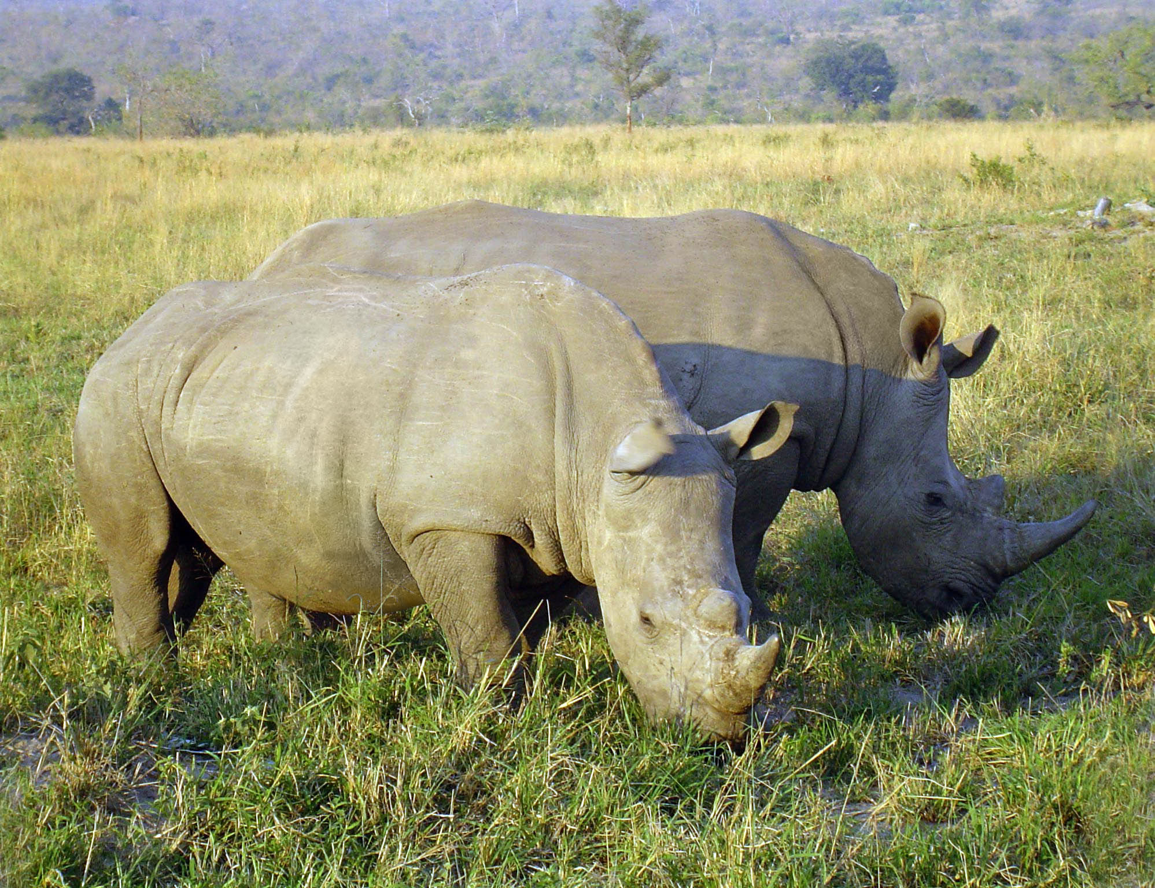
Why are species with small ranges more at risk of extinction?
No populations that can rescue the species if it’s extirpated (e.g. due to human pressure)
More sensitive to demographic stochasticity, inbreeding
Alee effect – strength in numbers when defending against predators, cooperative behavior
The rarer the more expensive, which further drives demand, which makes species even rarer (example: rhino horns)
Local populations in species with small ranges decline faster due to habitat loss (Staude et al. 2019)
Photo: Wikimedia Commons
Notes:
And this is what I will address
The grand objective is to figure out…
Specifically, BEAST will ………………………
I will do this in 5 work packages.

Slide 10

Official way to declare extinction risk: Red lists
International Union for Conservation of Nature
1,400 member organizations, 16,000 scientists, budget of 95 m EUR in 2012, UN observer
World Conservation Congress, World Parks Congress
Members from CZ: AOPK, ČSOP, MŽP, KRNAP, UCSZOO
Products:
- IUCN red list of species – based on population size (number of individuals), trends of population size, fragmentation, habitat quality, actual or potential exploitation, extent of occurrence (EEO), area of occurrence (AOO)
- IUCN red list of ecosystems
iucnredlist.org
Notes:
And this is what I will address
The grand objective is to figure out…
Specifically, BEAST will ………………………
I will do this in 5 work packages.

Slide 11
IUCN red list categories
iucnredlist.org
Notes:
And this is what I will address
The grand objective is to figure out…
Specifically, BEAST will ………………………
I will do this in 5 work packages.

Slide 12
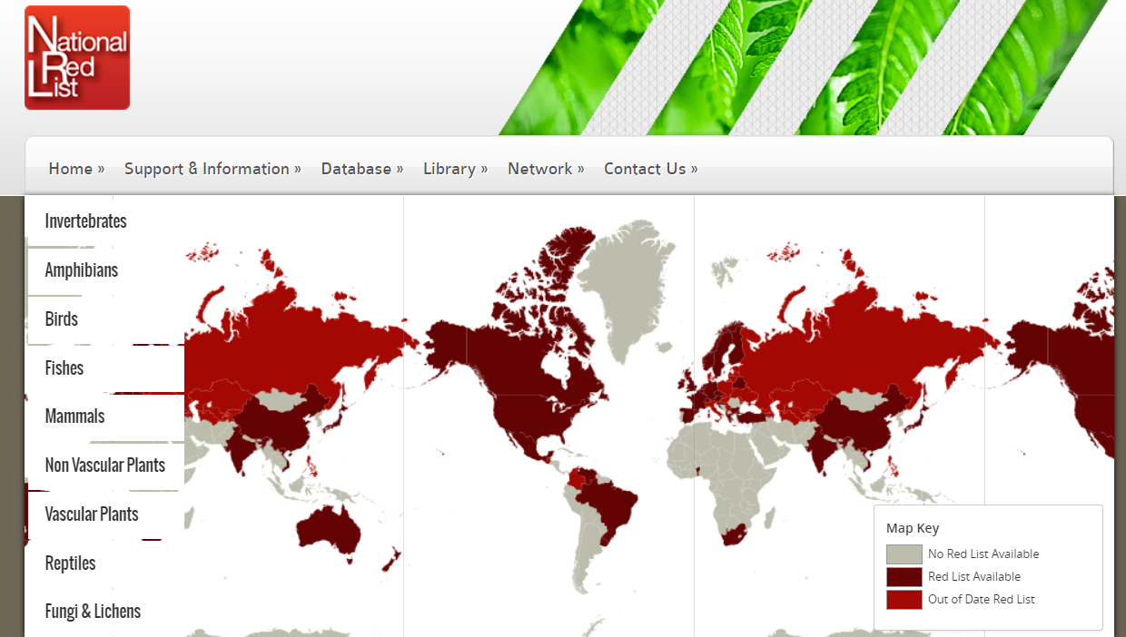

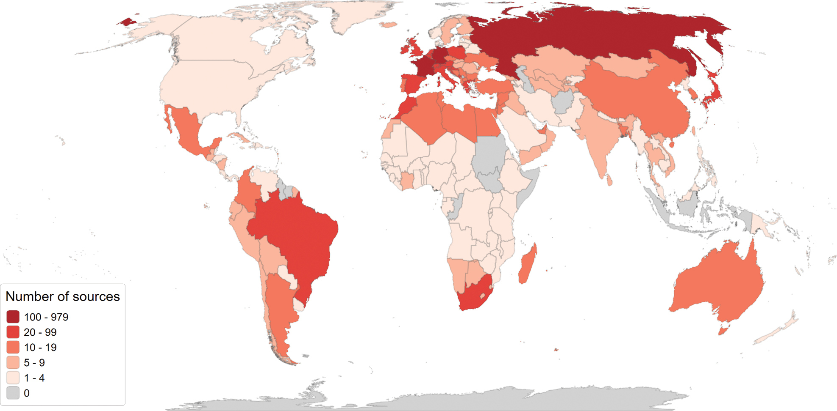
There are also smaller red lists: country-level, European level, …
In MOBI lab, we have been compiling a global database of species regional extinctions and threat statuses (Kadlec et al. 2025)
nationalredlist.org
Kadlec et al. (2025) Nature Conservation
Notes:
OK, so here we are moving to the outer space
Spaceborne satellite sensors such as MODIS or Landsat can classify landscape to spectral species, and can measure spectral diversity
Unlike taxonomic data, spectral data suffer no sampling bias and are available over any scale
In WP4 I will seek parallels between dynamics of taxonomic and spectral diversity

Slide 13
You should know
What is extinction, extirpation, and extinction risk
Name 2 cases of extinction, 2 cases of extirpation, and 2 species in the risk of extinction (not examples from this talk)
What are the main species traits affecting extinction risk
That AOO and EOO play a key role in assessment of extinction risk
The main authority in extinction risk assessment is IUCN
You should know the main risk categories
You should know what is a red list
Notes:
OK, so here we are moving to the outer space
Spaceborne satellite sensors such as MODIS or Landsat can classify landscape to spectral species, and can measure spectral diversity
Unlike taxonomic data, spectral data suffer no sampling bias and are available over any scale
In WP4 I will seek parallels between dynamics of taxonomic and spectral diversity

Slide 14
Range contractions and collapses
How species go extinct?
Notes:
I am qualified to deliver all this

Slide 15
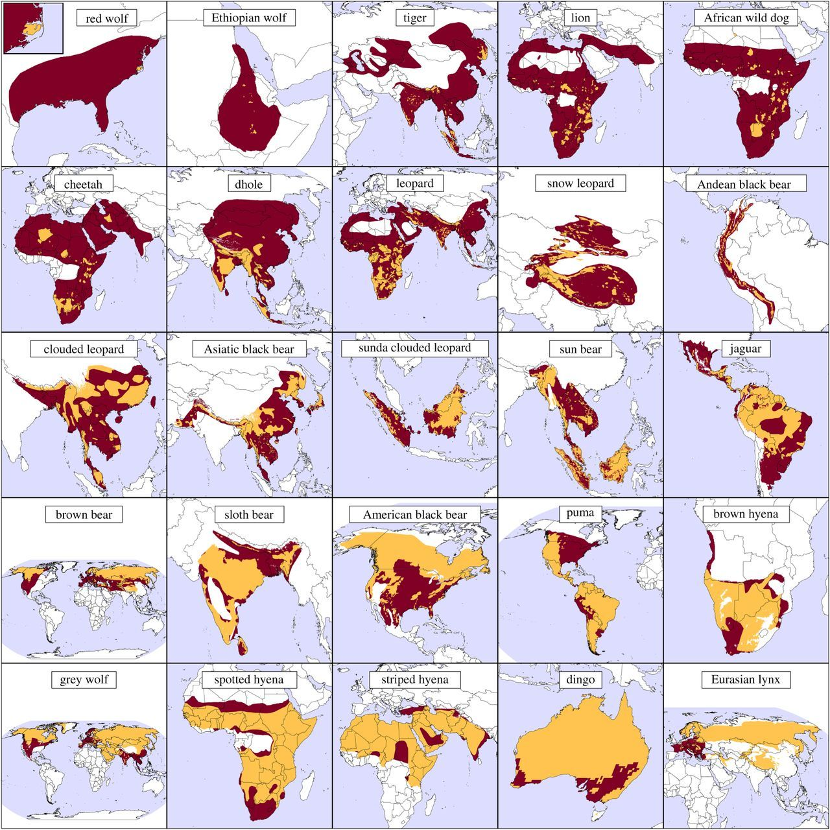
Mammal & large carnivore ranges: 1500 AD - present
173 terrestrial mammals have lost > 50% of native range. Most severe losses in areas with high human population density (Ceballos & Ehrlich 2002).
In North America, 17 out of 43 large ungulates underwent contractions of > 20% (Laliberte & Ripple 2004).
Less then 21% land retains its historic range of > 20 kg mammals (Morrison et al. 2007).
Maps: Wolf & Ripple (2017) Proc. R. Soc. B
Notes:
And this is what I will address
The grand objective is to figure out…
Specifically, BEAST will ………………………
I will do this in 5 work packages.

Slide 16
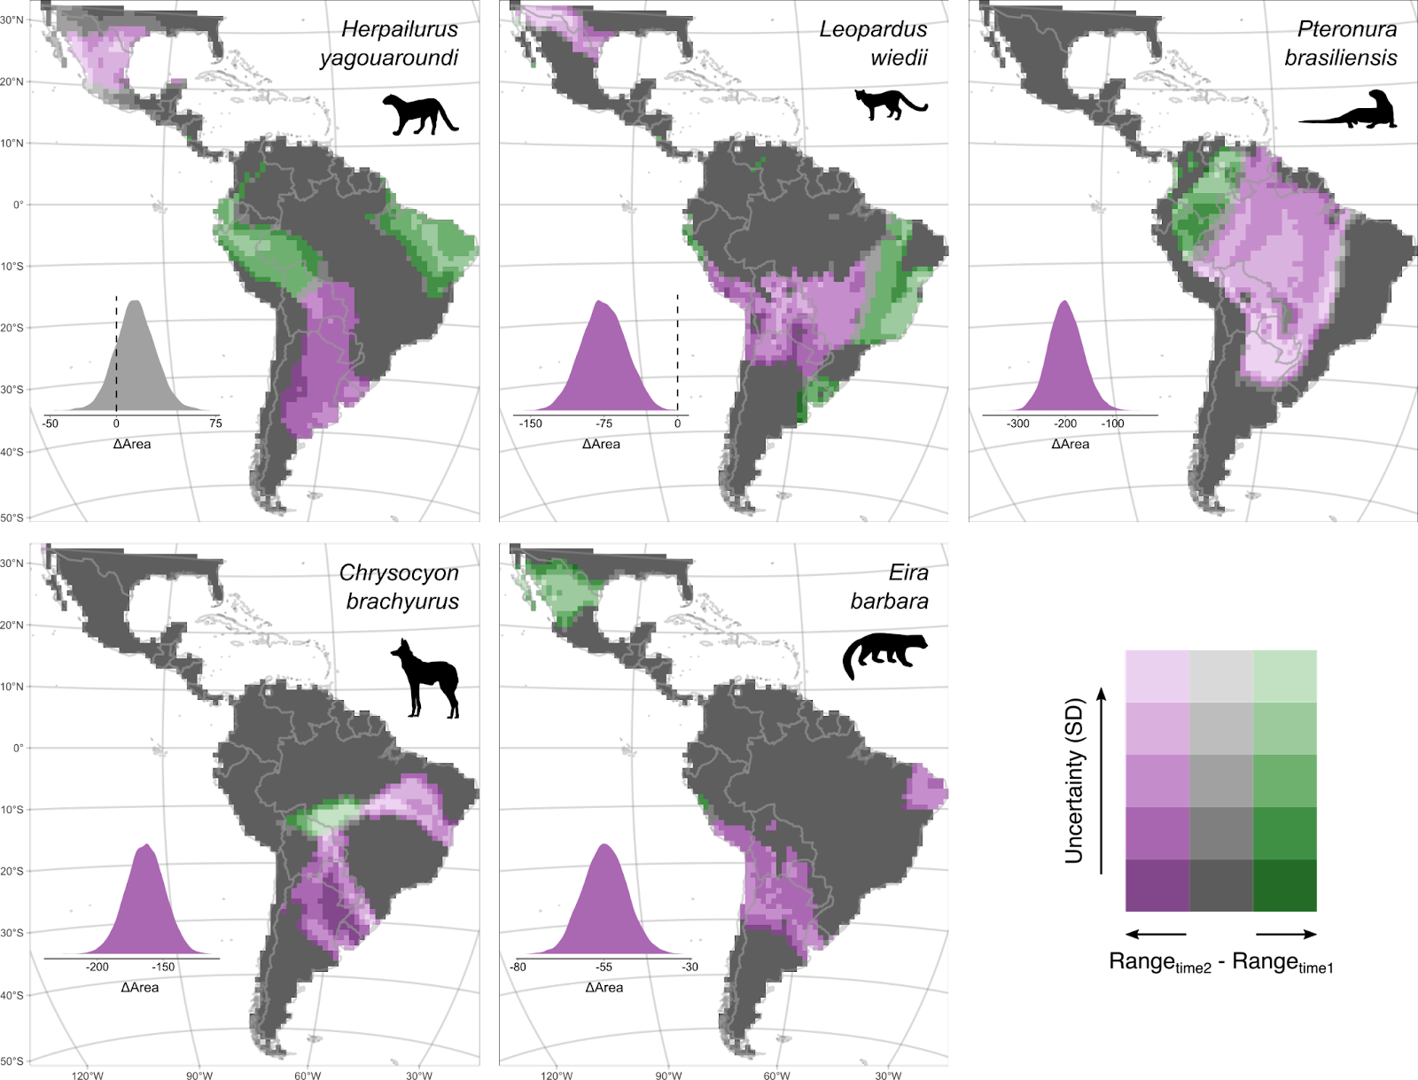

Neotropical carnivores
Grattarola et al. (2024) Glob. Ecol. Conserv.
Notes:
OK, so here we are moving to the outer space
Spaceborne satellite sensors such as MODIS or Landsat can classify landscape to spectral species, and can measure spectral diversity
Unlike taxonomic data, spectral data suffer no sampling bias and are available over any scale
In WP4 I will seek parallels between dynamics of taxonomic and spectral diversity

Slide 17
What drives current range contractions?
What do you think?
Notes:
And this is what I will address
The grand objective is to figure out…
Specifically, BEAST will ………………………
I will do this in 5 work packages.

Slide 18

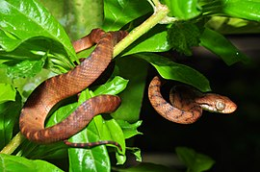
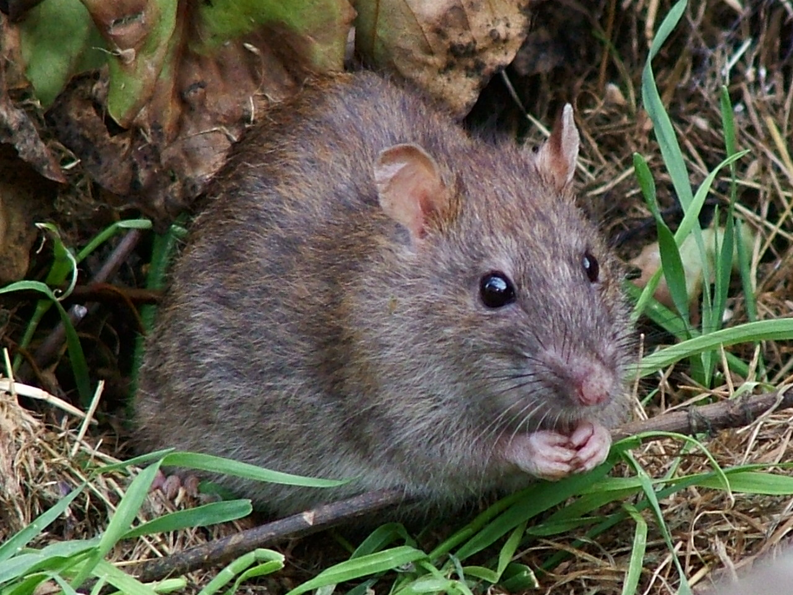
Global avian extinctions – it’s mostly islands and cats
Extinctions by realm
Extinctions by cause
Szabo et al. (2012) PLoS One
Notes:
OK, so here we are moving to the outer space
Spaceborne satellite sensors such as MODIS or Landsat can classify landscape to spectral species, and can measure spectral diversity
Unlike taxonomic data, spectral data suffer no sampling bias and are available over any scale
In WP4 I will seek parallels between dynamics of taxonomic and spectral diversity

Slide 19
Main drivers of range contractions and collapses
Threats by time
Threatened species by drivers
Pereira et al. (2012) Annual Rev. Env. Res.
Notes:
OK, so here we are moving to the outer space
Spaceborne satellite sensors such as MODIS or Landsat can classify landscape to spectral species, and can measure spectral diversity
Unlike taxonomic data, spectral data suffer no sampling bias and are available over any scale
In WP4 I will seek parallels between dynamics of taxonomic and spectral diversity

Slide 20
How do ranges contract? Geometry of range collapses
R. Wallace (1876) “On a continent, the process of extinction will take effect on the circumference of the area of distribution, because it is there that the species comes to contact with such adverse conditions or competing forms as prevent it from advancing further.”
“Melting range hypothesis” – Gaston et al. (2003) equal decline everywhere, with last populations around the center
Gaston et al. (2003) The structure and dynamics of species’ geographic ranges
Notes:
OK, so here we are moving to the outer space
Spaceborne satellite sensors such as MODIS or Landsat can classify landscape to spectral species, and can measure spectral diversity
Unlike taxonomic data, spectral data suffer no sampling bias and are available over any scale
In WP4 I will seek parallels between dynamics of taxonomic and spectral diversity

Slide 21
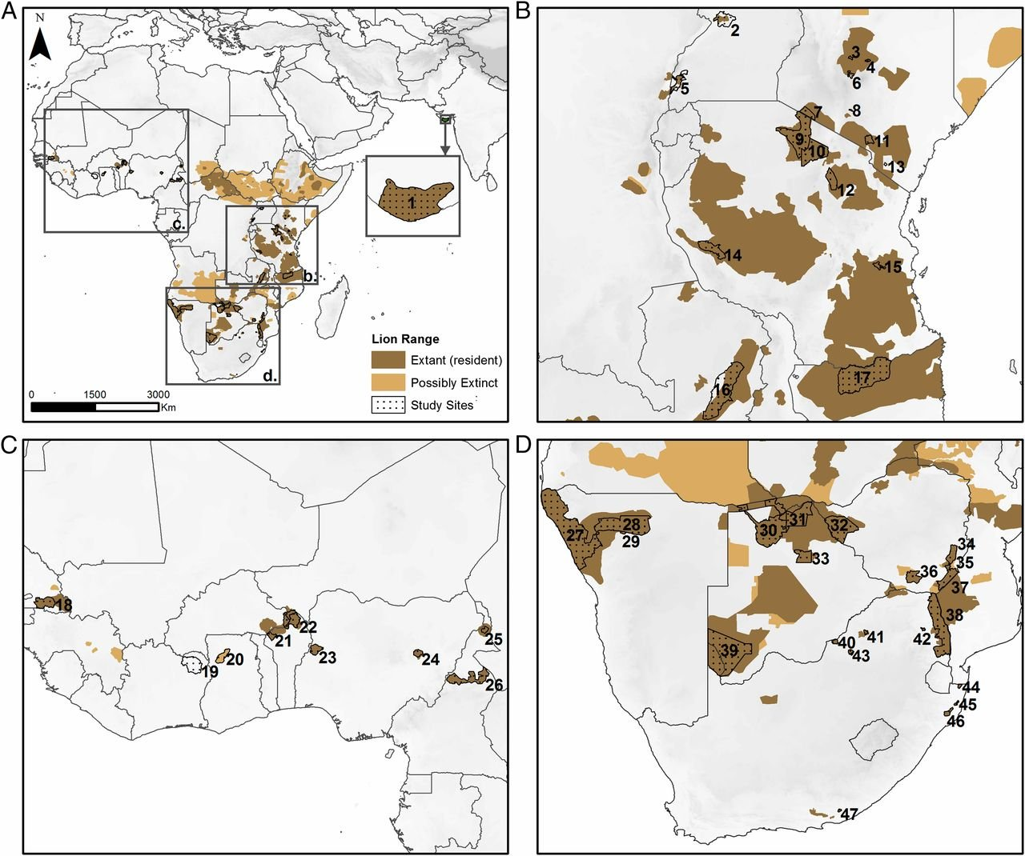
Empirical support for the melting range hypothesis is mixed
Panthera leo
Bauer et al. (2015) PNAS
Notes:
OK, so here we are moving to the outer space
Spaceborne satellite sensors such as MODIS or Landsat can classify landscape to spectral species, and can measure spectral diversity
Unlike taxonomic data, spectral data suffer no sampling bias and are available over any scale
In WP4 I will seek parallels between dynamics of taxonomic and spectral diversity

Slide 22
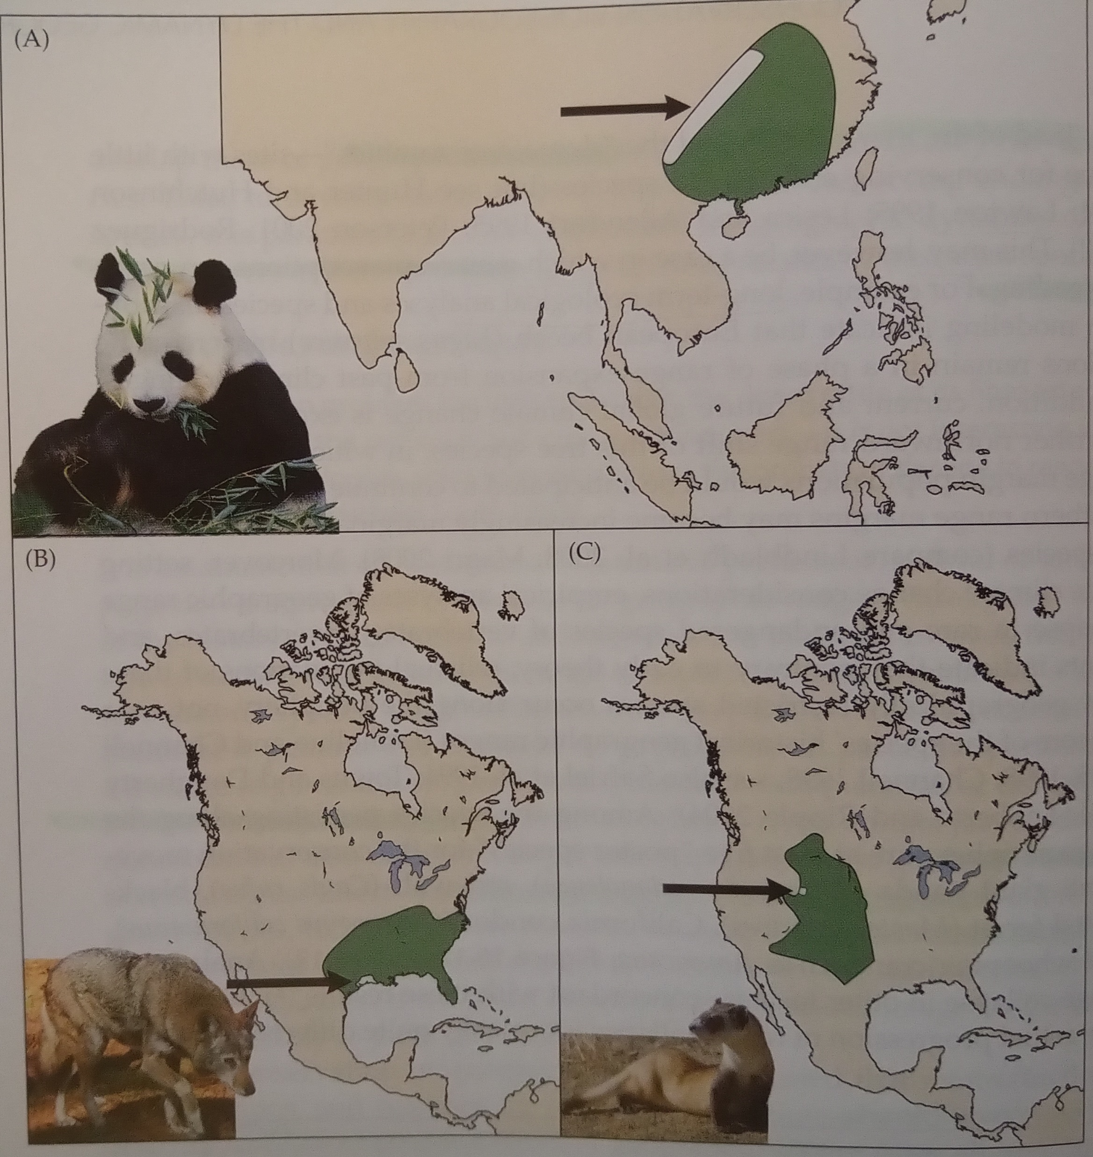
Empirical support for the melting range hypothesis is mixed
Iconic examples of species that persist around the edges:
Giant panda (Ailuropoda melanoleuca)
Red wolf (Canis rufus)
Whooping crane (Grus americana)
Lomolino et al. (2010) Biogeography
Notes:
OK, so here we are moving to the outer space
Spaceborne satellite sensors such as MODIS or Landsat can classify landscape to spectral species, and can measure spectral diversity
Unlike taxonomic data, spectral data suffer no sampling bias and are available over any scale
In WP4 I will seek parallels between dynamics of taxonomic and spectral diversity

Slide 23
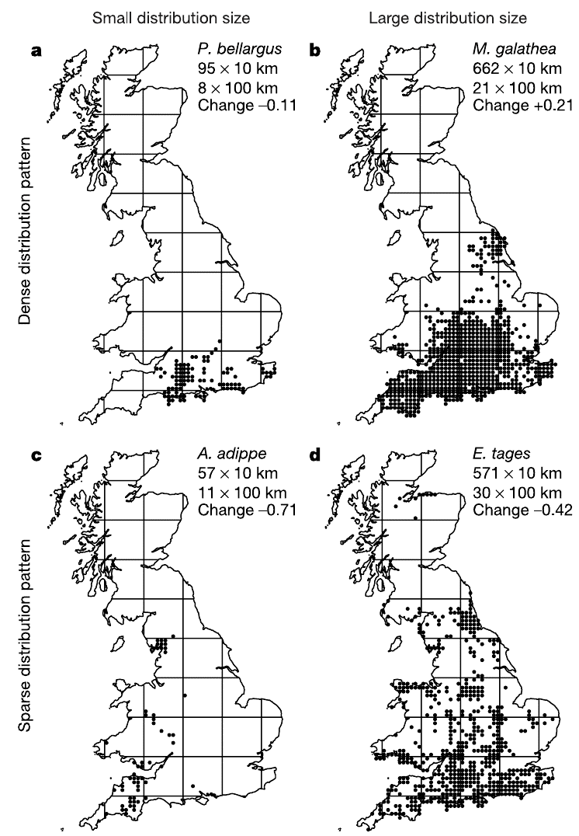
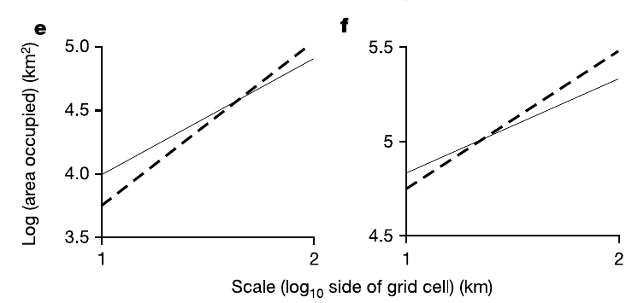
Species undergoing range collapse have different OAR*
* See previous lecture, and also Wilson et al. (2004) Nature
Notes:
OK, so here we are moving to the outer space
Spaceborne satellite sensors such as MODIS or Landsat can classify landscape to spectral species, and can measure spectral diversity
Unlike taxonomic data, spectral data suffer no sampling bias and are available over any scale
In WP4 I will seek parallels between dynamics of taxonomic and spectral diversity

Slide 24
You should know that
Range collapses, local extinctions, range contractions, and entire losses of ranges (global extinctions) are widespread, yet difficult to quantify. Reason: It’s difficult to determine that something disappeared completely.
By far the most documented range collapses and extinctions happen on islands.
Range collapses happen in many ways. There is no wide support that the center of the range disappears last.
Main drivers of range collapses are habitat loss, exploitation, and invasive species
Notes:
OK, so here we are moving to the outer space
Spaceborne satellite sensors such as MODIS or Landsat can classify landscape to spectral species, and can measure spectral diversity
Unlike taxonomic data, spectral data suffer no sampling bias and are available over any scale
In WP4 I will seek parallels between dynamics of taxonomic and spectral diversity

Slide 25
Range expansions
Notes:
I am qualified to deliver all this

Slide 26
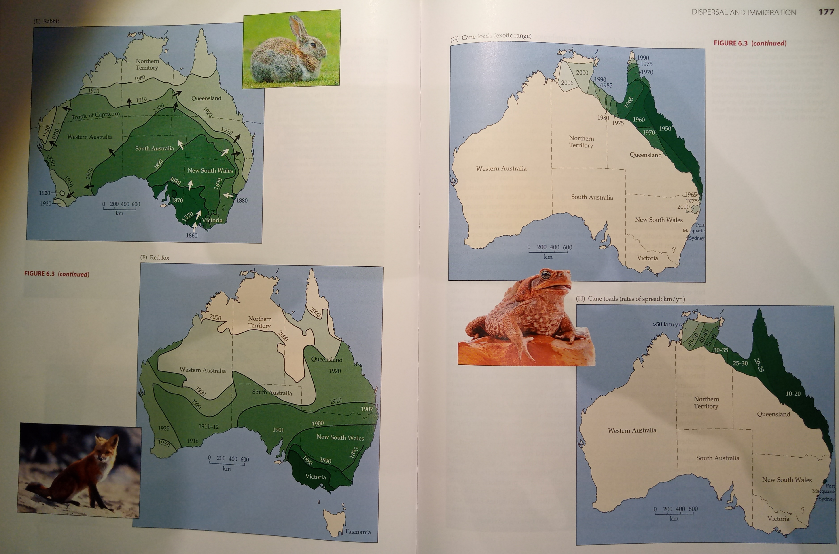
Invasive species – usually a continuous spread
Maps: Lomolino et al. (2010) Biogeography
Notes:
And this is what I will address
The grand objective is to figure out…
Specifically, BEAST will ………………………
I will do this in 5 work packages.

Slide 27
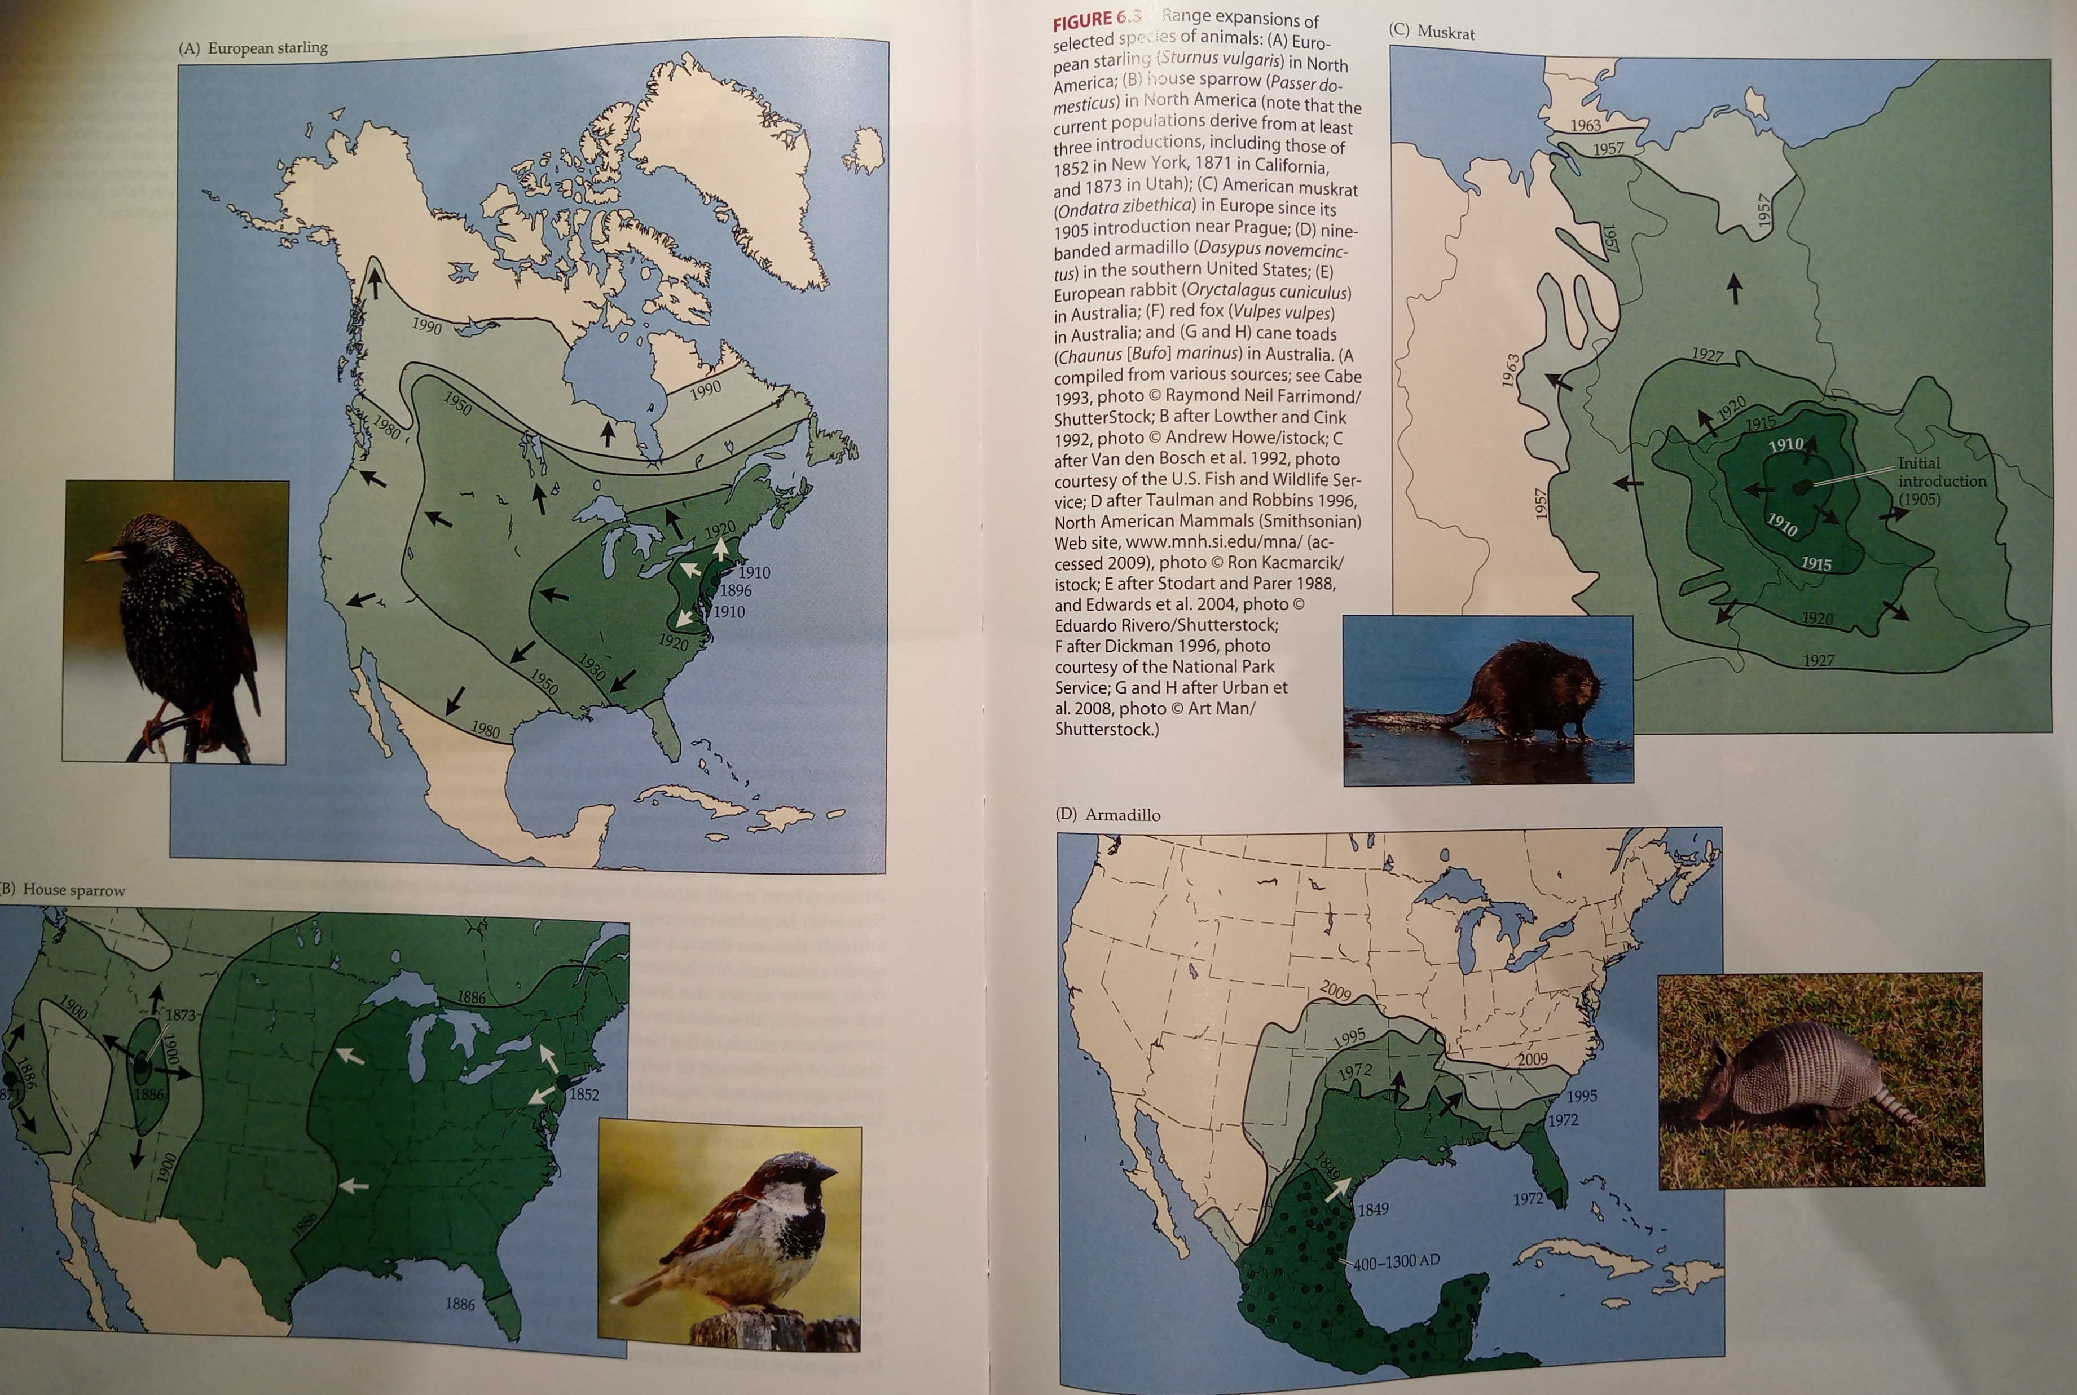
Invasive species – usually a continuous spread
Ondatra zibethica
(American muskrat)
First introduction in 1905 in Prague
Maps: Lomolino et al. (2010) Biogeography
Notes:
And this is what I will address
The grand objective is to figure out…
Specifically, BEAST will ………………………
I will do this in 5 work packages.

Slide 28
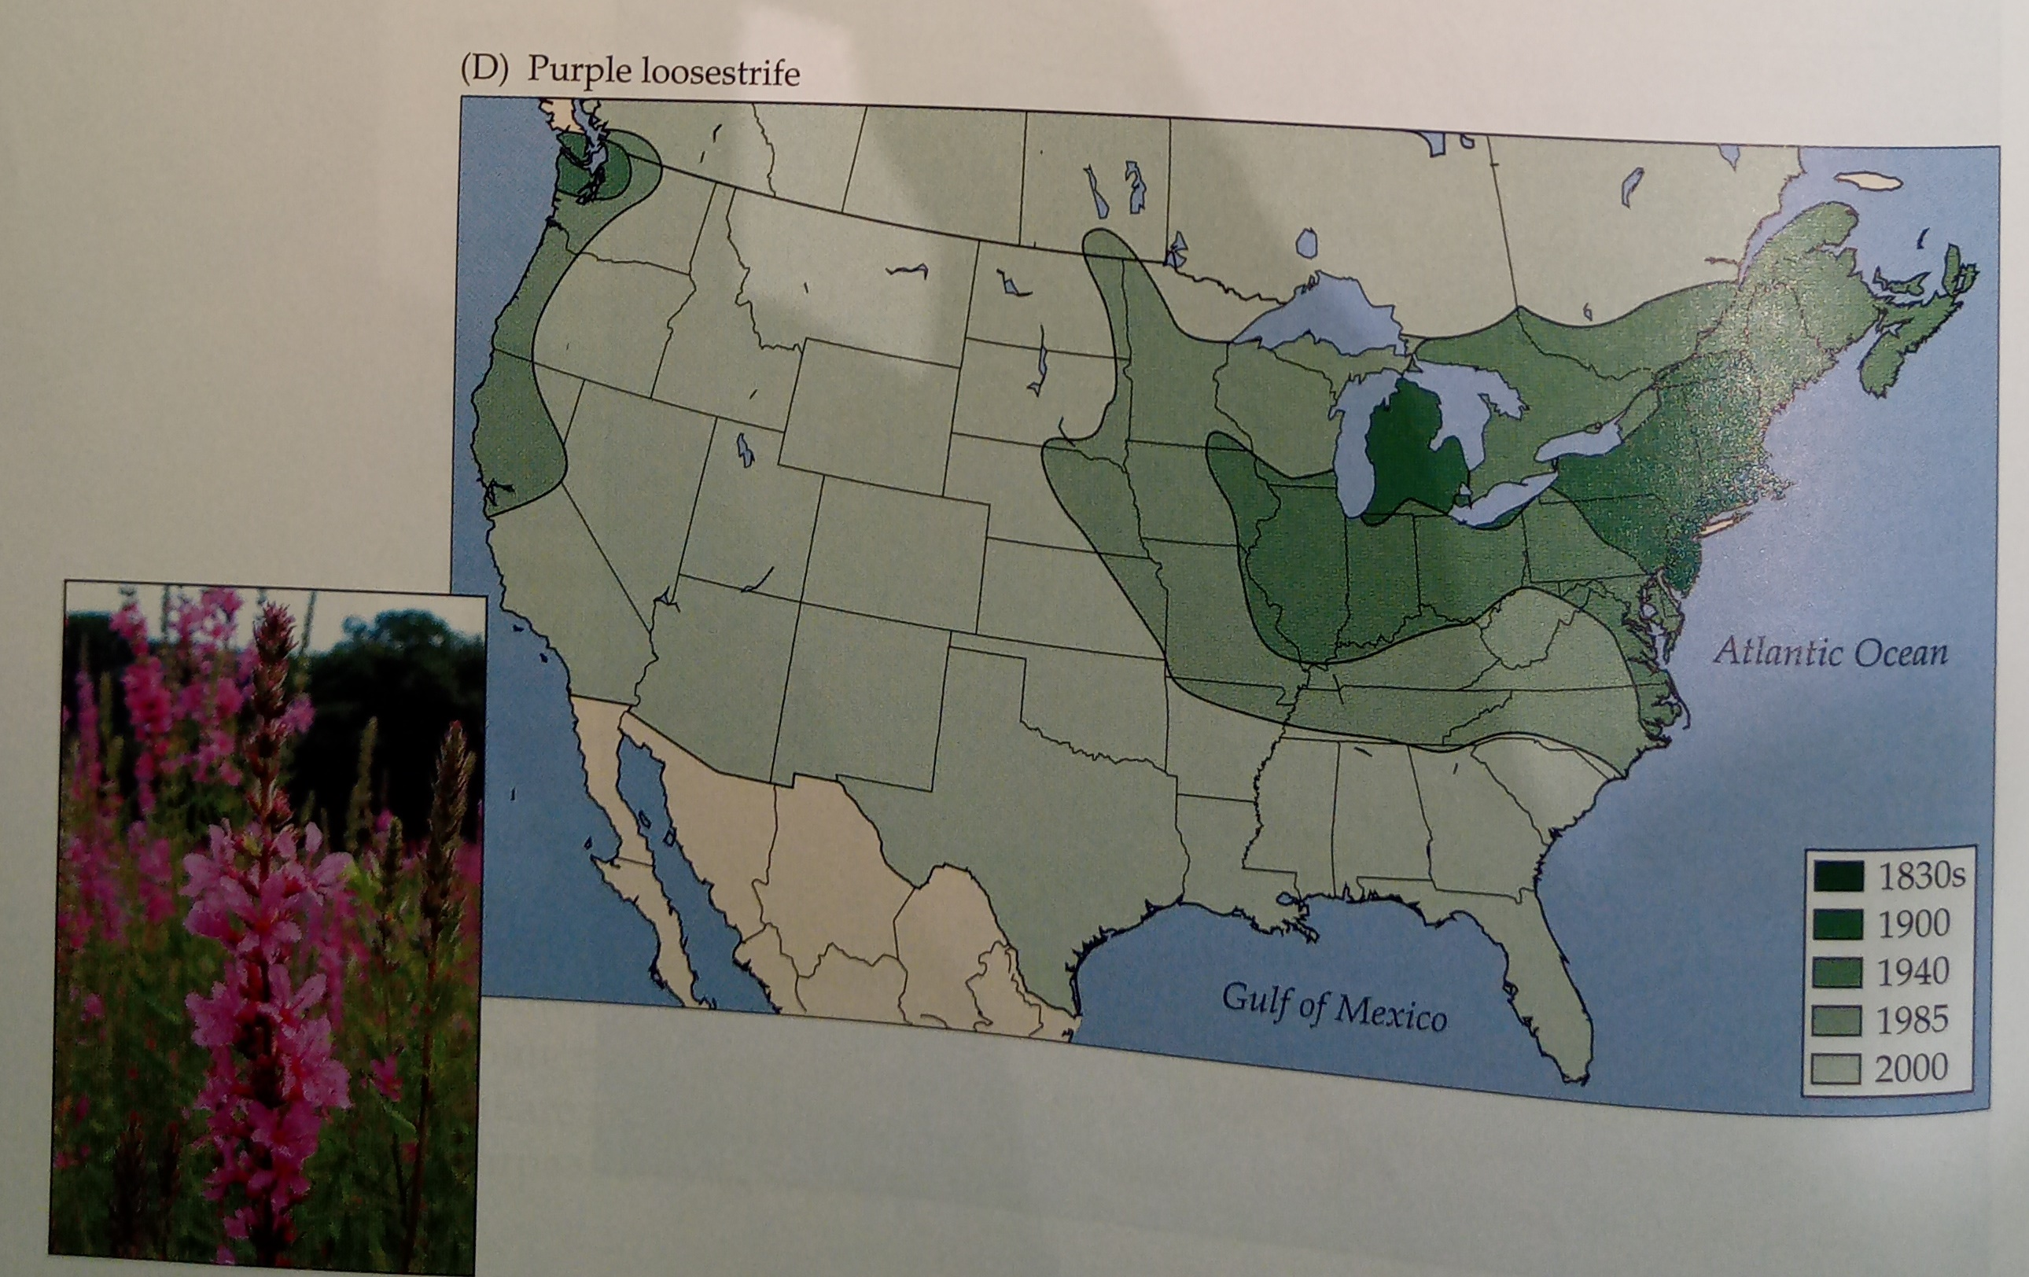
Invasive species – usually a continuous spread
Lythrum salicaria
(Kyprej vrbice)
Maps: Lomolino et al. (2010) Biogeography
Notes:
And this is what I will address
The grand objective is to figure out…
Specifically, BEAST will ………………………
I will do this in 5 work packages.

Slide 29
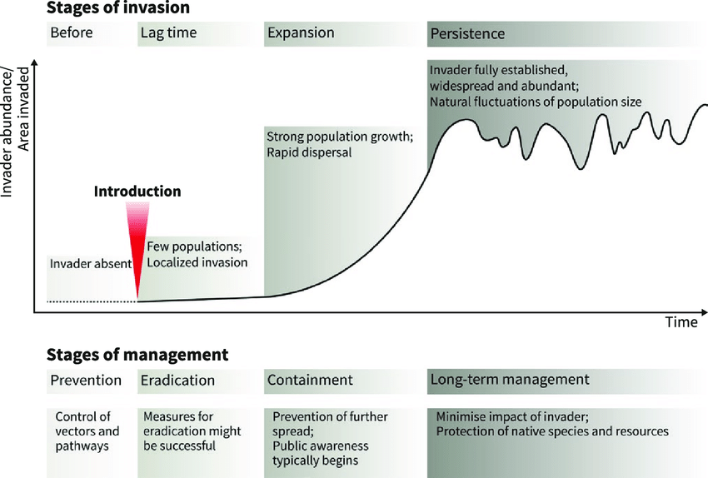
Invasive species
Boudouresque et al. (2005)
Notes:
And this is what I will address
The grand objective is to figure out…
Specifically, BEAST will ………………………
I will do this in 5 work packages.

Slide 30
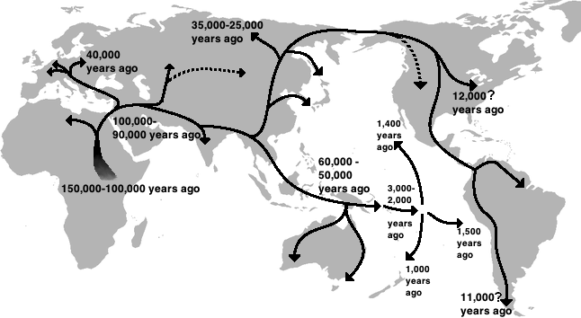
Human spread out of Africa
Map: Kyushu Museum
Notes:
And this is what I will address
The grand objective is to figure out…
Specifically, BEAST will ………………………
I will do this in 5 work packages.

Slide 31
You should know
How invasive species proceed from introduction to full invasion
Continuous spread outwards is the most common pattern of range expansion
Notes:
OK, so here we are moving to the outer space
Spaceborne satellite sensors such as MODIS or Landsat can classify landscape to spectral species, and can measure spectral diversity
Unlike taxonomic data, spectral data suffer no sampling bias and are available over any scale
In WP4 I will seek parallels between dynamics of taxonomic and spectral diversity

Slide 32
Zooming in – spatial structure of populations
An intro to metapopulation ecology
Notes:
I am qualified to deliver all this

Slide 33
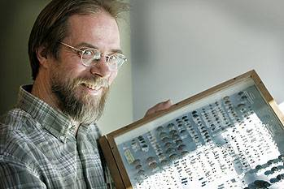
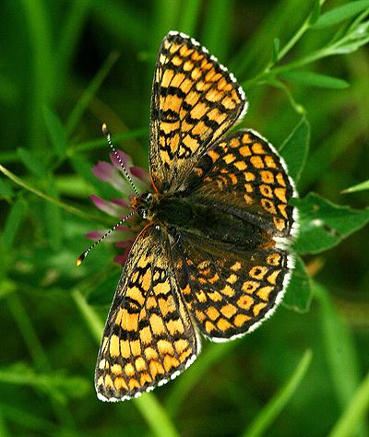
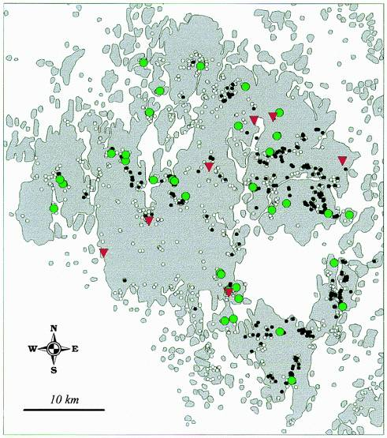
“The world is patchy”
Ilkka Hanski
Melitaea cinxia
(hnědásek kostkovaný)
Åland archipelago (Finland)
4000 patches
400 of them occupied
Hanski (1999) Metapopulation Ecology
Hanski (2011) PNAS
Notes:
And this is what I will address
The grand objective is to figure out…
Specifically, BEAST will ………………………
I will do this in 5 work packages.

Slide 34
Metapopulation = population of populations
Notes:
And this is what I will address
The grand objective is to figure out…
Specifically, BEAST will ………………………
I will do this in 5 work packages.

Slide 35
Metapopulation = population of populations
Notes:
And this is what I will address
The grand objective is to figure out…
Specifically, BEAST will ………………………
I will do this in 5 work packages.

Slide 36
Metapopulation = population of populations
Notes:
And this is what I will address
The grand objective is to figure out…
Specifically, BEAST will ………………………
I will do this in 5 work packages.

Slide 37
Metapopulation = population of populations
Notes:
And this is what I will address
The grand objective is to figure out…
Specifically, BEAST will ………………………
I will do this in 5 work packages.

Slide 38
Metapopulation = population of populations
A metapopulation is a population of populations distributed in discrete habitat patches that are linked by occasional dispersal.
Rather than track individual organisms through time, a metapopulation approach tracks the occupancy of habitat patches through time.
Metapopulation models can be used to examine factors that cause patch colonizations or patch extinctions.
Hanski (1999) Metapopulation Ecology
Van Nouhuys (2016) Metapopulation Ecology
Notes:
And this is what I will address
The grand objective is to figure out…
Specifically, BEAST will ………………………
I will do this in 5 work packages.

Slide 39
How common are metapopulations?
Strict metapopulations are probably uncommon, but metapopulation processes can play a role in many species
Useful theoretical concept that can be extended to be more realistic
Van Nouhuys (2016) Metapopulation Ecology
Notes:
And this is what I will address
The grand objective is to figure out…
Specifically, BEAST will ………………………
I will do this in 5 work packages.

Slide 40
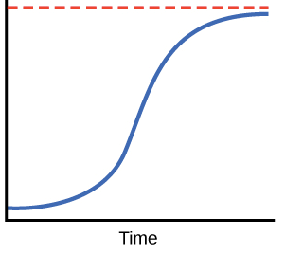
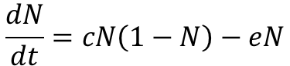
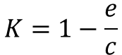
Levins’ model
N… proportion of occupied sites
c… colonization probability
e… extinction probability
t… time
K… carrying capacity
K
N
$$\frac{dN}{dt}=cN\left(1−N\right)−eN$$
$$K=1−\frac{e}{c}$$
At equilibrium, some fraction of the patches can constantly be unoccupied.
Van Nouhuys (2016) Metapopulation Ecology
Levins (1969) Bull. Entomol. Soc. Amer.
Notes:
And this is what I will address
The grand objective is to figure out…
Specifically, BEAST will ………………………
I will do this in 5 work packages.

Slide 41
Extensions of Levins’ model include:
Rescue effect – extinction rates are low in systems with high N (Hanski 1985)
Larger populations are less likely to go extinct (Hastings & Wolin 1989)
Larger empty patches are more likely to be colonized (Hastings & Wolin 1989)
Species interactions (Nee & May 1992)
Colonization is determined by connectivity (connected patches are more likely to be colonized; Hanski 1994)
Source & sink populations
Van Nouhuys (2016) Metapopulation Ecology
Notes:
OK, so here we are moving to the outer space
Spaceborne satellite sensors such as MODIS or Landsat can classify landscape to spectral species, and can measure spectral diversity
Unlike taxonomic data, spectral data suffer no sampling bias and are available over any scale
In WP4 I will seek parallels between dynamics of taxonomic and spectral diversity

Slide 42
You should know
What is a metapopulation
How common are metapopulation in real world, and where they stand on the continuum between continuous large population and completely fragmented one
That there is the Levins’ model, that it models occupancy of patches, and that it is a logistic curve
That a stable metapopulation state might be only partial occupancy that fluctuates around an equilibrium
What is a source and sink population
Notes:
OK, so here we are moving to the outer space
Spaceborne satellite sensors such as MODIS or Landsat can classify landscape to spectral species, and can measure spectral diversity
Unlike taxonomic data, spectral data suffer no sampling bias and are available over any scale
In WP4 I will seek parallels between dynamics of taxonomic and spectral diversity

Slide 43
Thank you. Questions?

